Slide 1
Design and Implementation of a Communication Network
for the Project MURMEL
Master Thesis
Yilmaz Naci Aslan
Supervisors : Prof. Dr.-Ing. Dietmar Göhlich
: M.Sc. Abhishek Gupta
Department of Methods of product development and mechatronics
11.05.2021

Slide 2
Agenda
Introduction
Connectivity of robots
Connectivity of smart dustbins
MURMEL Application Server Overview
Simulation
Conclusion / Reference to Future Work

Slide 3
Introduction

Slide 4
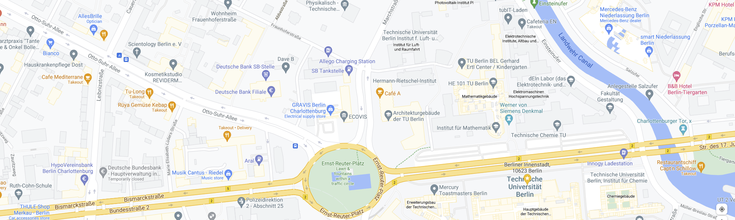
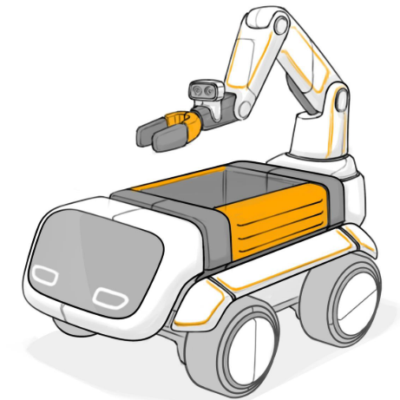
Introduction
Current state: Self driving capable robot on a given route.

Slide 5
Introduction
Current state: Self driving capable robot on a given route.
A fleet of robots requires coordination and communication for operational planning.

Slide 6
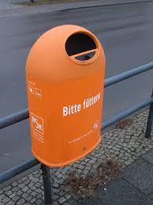
Introduction
Current state: Self driving capable robot on a given route.
A fleet of robots requires coordination and communication for operational planning.
Smart dustbins require communication modules

Slide 7
Introduction
Current state: Self driving capable robot on a given route.
A fleet of robots requires coordination and communication for operational planning.
Smart dustbins require communication modules
Foundations of requirements for building a communication network for MURMEL.
Online System Monitoring
Over the Air (OTA) Software Update
Route Optimization with Smart Dustbins
Accessing to Robots in Emergency Situations

Slide 8
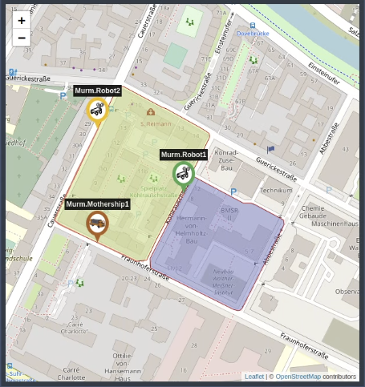
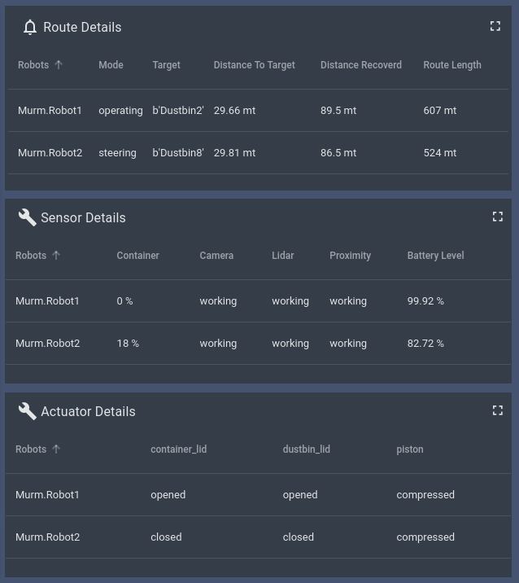
Introduction
Online System Monitoring
Robot Tracking Map
Telemetry Data Monitoring
Use cases
Geolocation & Robot Tracking
Following the route details
Monitoring the crucial state of the vehicle components such as
sensors
actuators
Dustbin lid opened
Garbage pressed
Dustbin lid closed

Slide 9
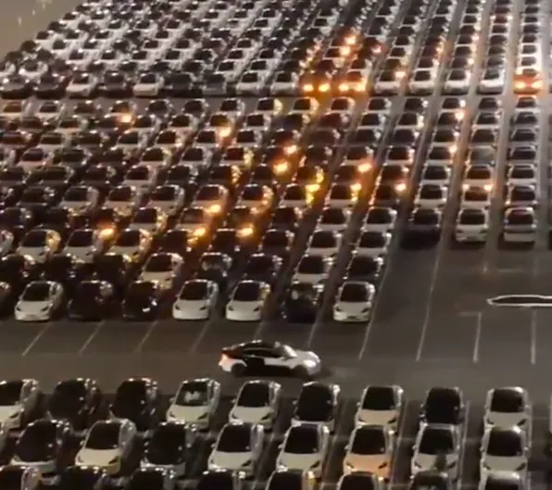
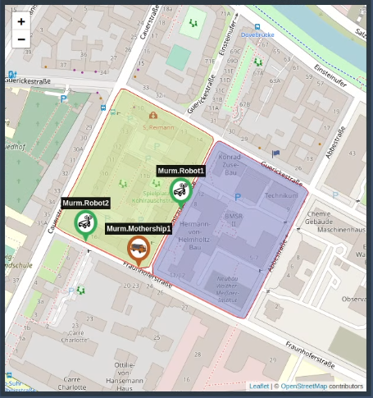
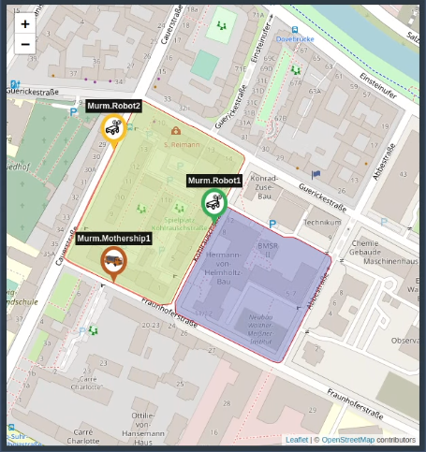
Introduction
Over The Air (OTA) Software Update
Example of OTA: Tesla Software Update
Dynamic Route Update to robots
Use cases
Sending software updates to robots
Improved algorithms
ROS update
Assigning routes to the robots
Updating routes in exceptional situations
Before
After
Source: https://teslanorth.com/2021/02/08/tesla-software-update-wirelessly-rolls-out-to-massive-fleet-of-cars-looks-incredible-video/

Slide 10
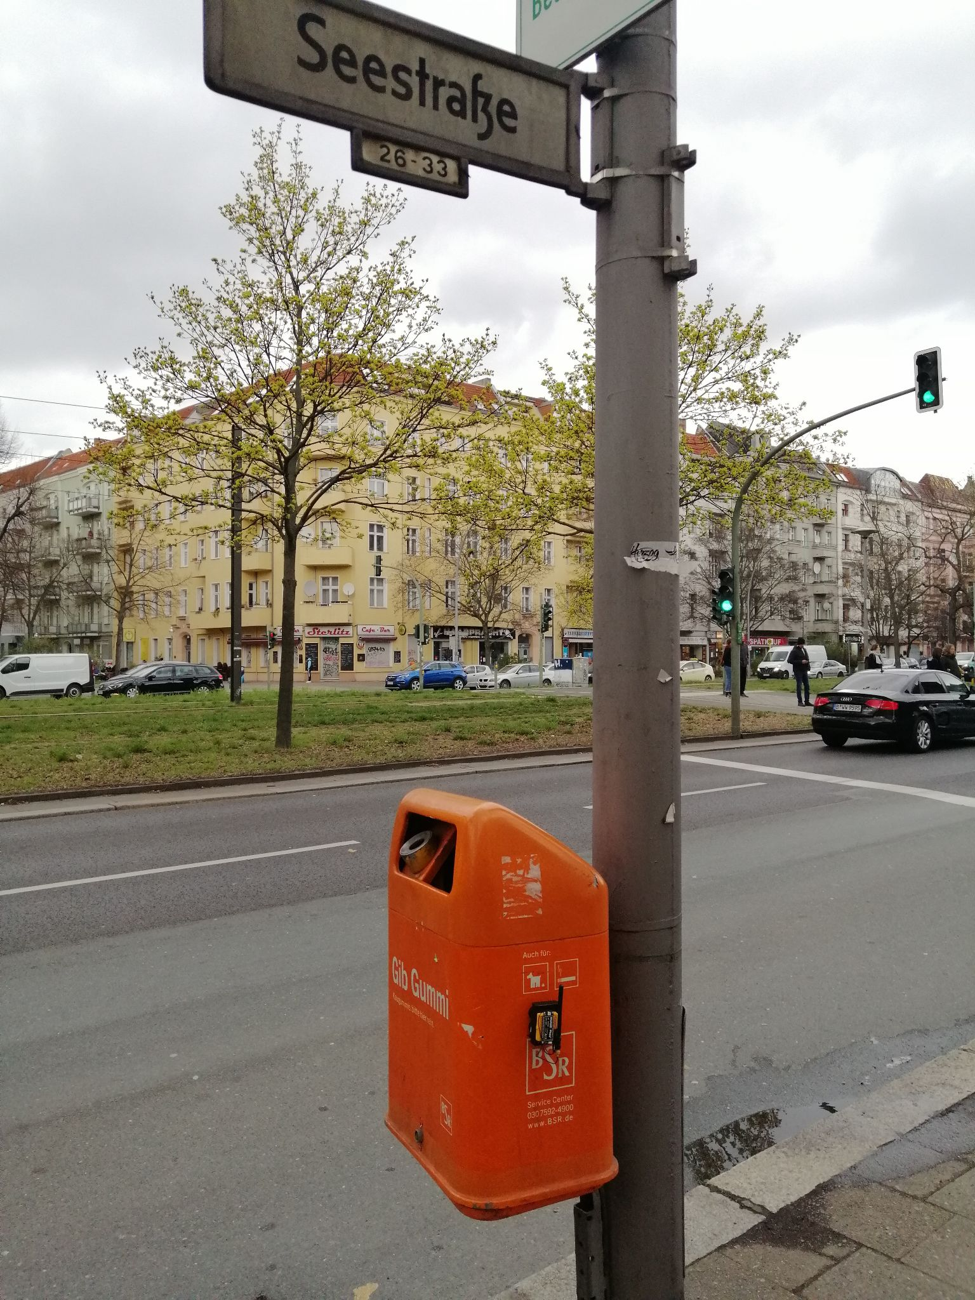
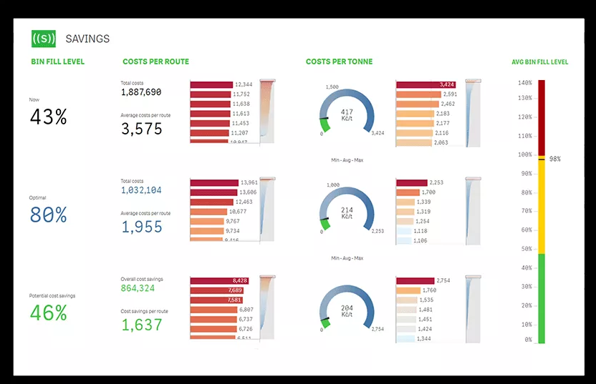

Introduction
Route Optimization with Smart Dustbins
Smart Dustbin Prototype
Sample Route Planning Engine
Use cases
Collecting fullness level data from dustbins
Optimization of the routes of disposal vehicles
avoidance of empty trips
less energy usage
Improving operational efficiency
Source:
https://sensoneo.com/optimize-waste-collection-routes/

Slide 11
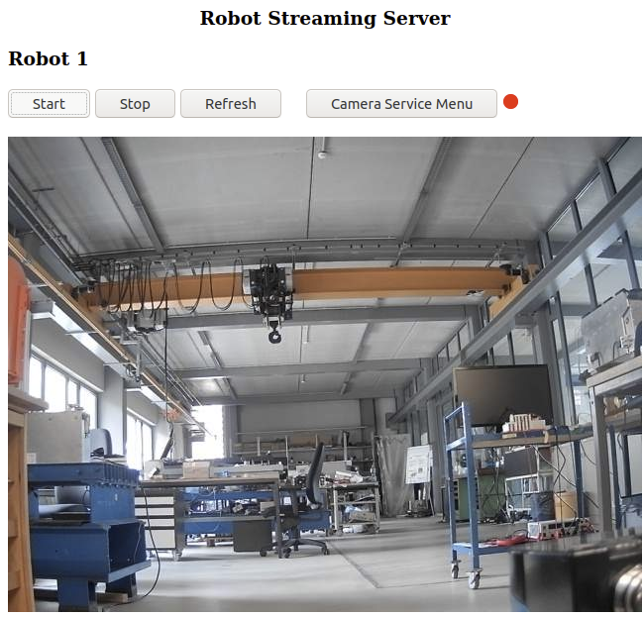
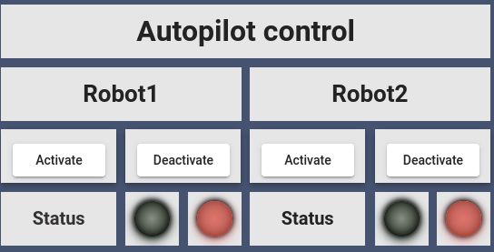
Introduction
Accessing to robots in emergencies
MURMEL Robot Streaming Server
Autopilot control panel of the dashboard
Use cases
Streaming live video from robots
Identifying the problems
Is the robot stuck?
Is there an object in front of the dustbin ?
Emergency break
Enable/disable the autopilot mode

Slide 12
2. Cloud Connectivity of Robots

Slide 13
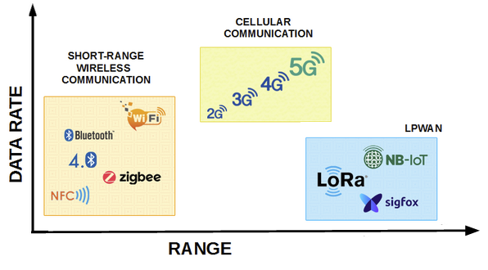
2. Cloud Connectivity of Robots
Wireless Communication Technologies
Source: https://www.embien.com/blog/introduction-to-lora-technology/
Notes:
Compromise between data rate and range

Slide 14
2. Cloud Connectivity of Robots
Wireless Communication Technologies
Comparison between wireless communication technologies
Features | SR Wireless Communication | Cellular Communication | LPWAN (Low Power Wide Area Network)
Range | ~400m | 2-5 km | 5-40 km
Data Rate/Bandwidth | High / Medium / Low | High | Low
Source: https://www.embien.com/blog/introduction-to-lora-technology/

Slide 15
2. Cloud Connectivity of Robots
Wireless Communication Technologies
Comparison between wireless communication technologies
Features | SR Wireless Communication | Cellular Communication | LPWAN (Low Power Wide Area Network)
Range | ~400m | 2-5 km | 5-40 km
Data Rate/Bandwidth | High / Medium / Low | High | Low
Power Consumption | Moderate | High | Low
Source: https://www.embien.com/blog/introduction-to-lora-technology/

Slide 16
2. Cloud Connectivity of Robots
Wireless Communication Technologies
Comparison between wireless communication technologies
Features | SR Wireless Communication | Cellular Communication | LPWAN (Low Power Wide Area Network)
Range | ~400m | 2-5 km | 5-40 km
Data Rate/Bandwidth | High / Medium / Low | High | Low
Power Consumption | Moderate | High | Low
Network usage fee | None | Relatively High | None / relatively Low
Source: https://www.embien.com/blog/introduction-to-lora-technology/

Slide 17
2. Cloud Connectivity of Robots
Wireless Communication Technologies
Comparison between wireless communication technologies
Features | SR Wireless Communication | Cellular Communication | LPWAN (Low Power Wide Area Network)
Range | ~400m | 2-5 km | 5-40 km
Data Rate/Bandwidth | High / Medium / Low | High | Low
Power Consumption | Moderate | High | Low
Network usage fee | None | Relatively High | None / relatively Low
Source: https://www.embien.com/blog/introduction-to-lora-technology/
Underlying physical wireless communication technologies for smart dustbins and robots must be chosen separately.

Slide 18
2. Cloud Connectivity of Robots
Connectivity of Robots
Requirements
High Bandwidth
High Data rate (4 Mbps)
MJPEG coding,
1920x1080
30 fps
Source: https://www.embien.com/blog/introduction-to-lora-technology/

Slide 19
2. Cloud Connectivity of Robots
Connectivity of Robots
Requirements
High Bandwidth
High Data rate (4 Mbps)
MJPEG coding,
1920x1080
30 fps
Source: https://www.embien.com/blog/introduction-to-lora-technology/

Slide 20
2. Cloud Connectivity of Robots
Connectivity of Robots
Requirements
High Bandwidth
High Data rate (4 Mbps)
MJPEG coding,
1920x1080
30 fps
Source: https://www.embien.com/blog/introduction-to-lora-technology/
3G Networks have started to being shut down.
Switch Off Data | Network Operator | Country
Dezember 2020 | Verizon | USA
February 2022 | AT&T | USA
June 2019 | Airtel | India
June 2021 | Vodafone | Germany&Netherlands

Slide 21
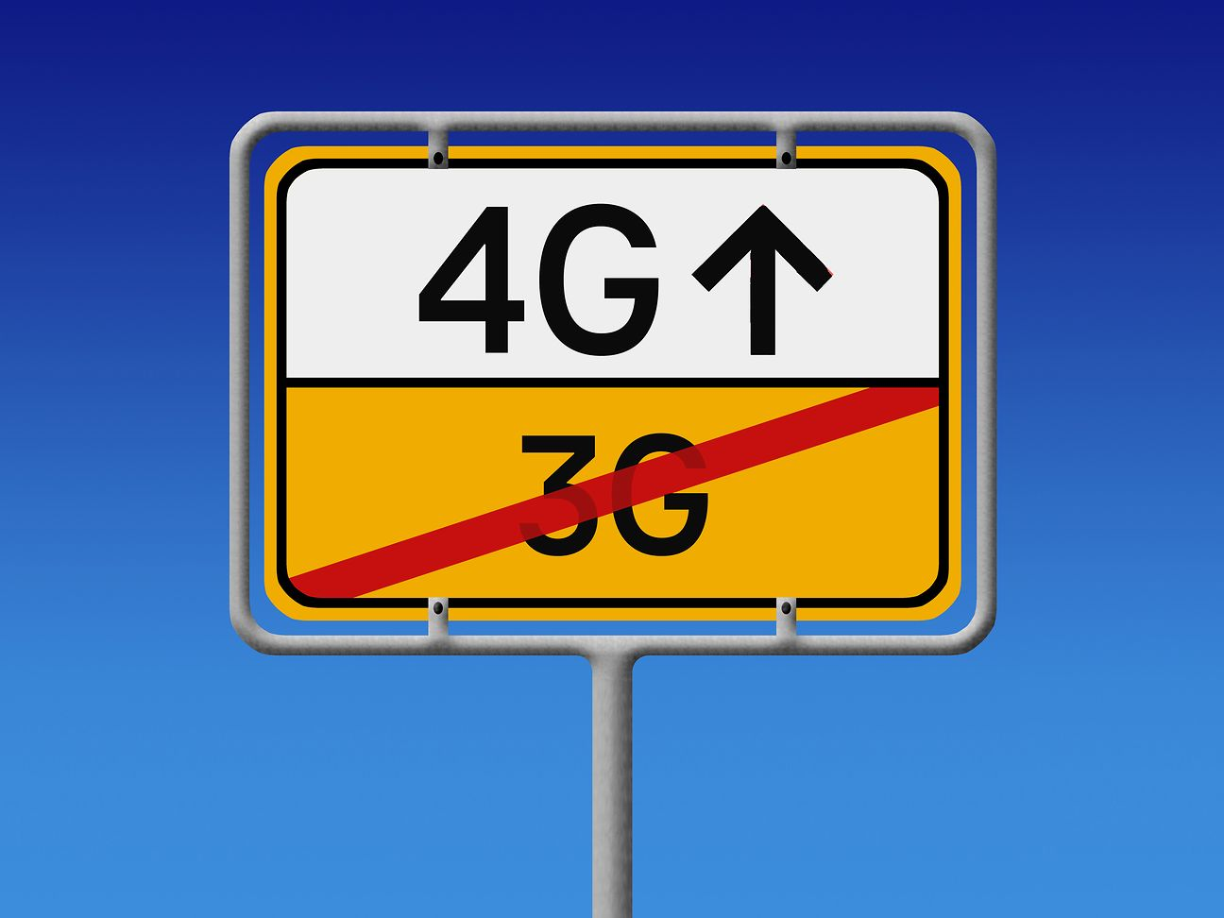
2. Cloud Connectivity of Robots
Connectivity of Robots
Requirements
High Bandwidth
High Data rate (4 Mbps)
MJPEG coding,
1920x1080
30 fps
Source: https://www.embien.com/blog/introduction-to-lora-technology/
3G Networks have started to being shut down.
Switch Off Data | Network Operator | Country
Dezember 2020 | Verizon | USA
February 2022 | AT&T | USA
June 2019 | Airtel | India
June 2021 | Vodafone | Germany&Netherlands
From 30 June 2021, Telekom's 3G network in Germany will be switched off, making room for faster technologies.
Source:
https://www.telekom.com/en/media/media-information/archive/bye-bye-3g-now-lte-is-coming-for-everyone-608220

Slide 22
2. Cloud Connectivity of Robots
All the products build with 3G modems will need a hardware update in the close future.

Slide 23
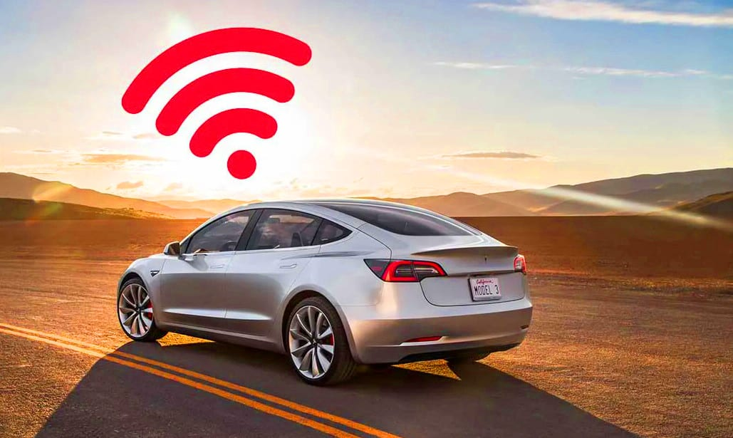
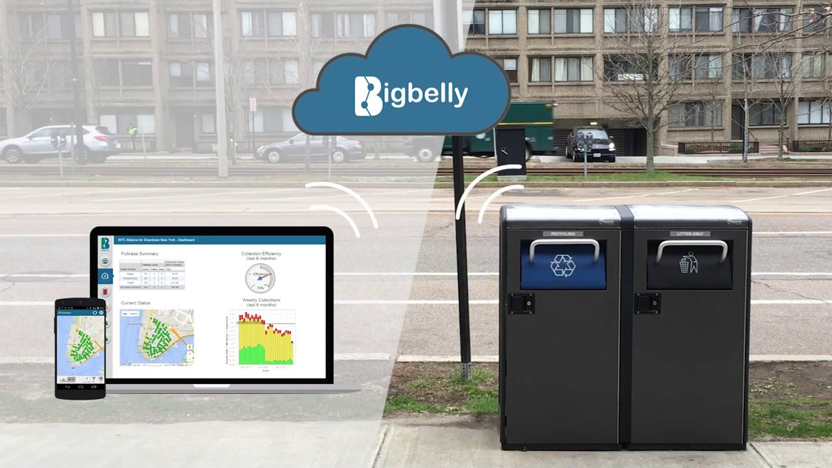
2. Cloud Connectivity of Robots
All the products build with 3G modems will need a hardware update in the close future.
2014 Tesla S models will require hardware update
2G/3G based M2M communication applications are also affected.
https://grubermotors.com/services/model-s-x-4g-lte-upgrade/
https://www.taoglas.com/bigbelly-uses-taoglas-antennas-to-create-smart-trash-cans/

Slide 24
2. Cloud Connectivity of Robots
All the products build with 3G modems will need a hardware update in the close future.
2014 Tesla S models will require hardware update
2G/3G based M2M communication applications are also affected.
https://grubermotors.com/services/model-s-x-4g-lte-upgrade/
https://www.taoglas.com/bigbelly-uses-taoglas-antennas-to-create-smart-trash-cans/
 | 2G/3G | 4G/LTE | 5G
Compatibility | x | ✔ | ✔

Slide 25
2. Cloud Connectivity of Robots
All the products build with 3G modems will need a hardware update in the close future.
2014 Tesla S models will require hardware update
2G/3G based M2M communication applications are also affected.
https://grubermotors.com/services/model-s-x-4g-lte-upgrade/
https://www.taoglas.com/bigbelly-uses-taoglas-antennas-to-create-smart-trash-cans/
 | 2G/3G | 4G/LTE | 5G
Compatibility | x | ✔ | ✔
MURMEL robots don't require the high speed and low latency provided by 5G.

Slide 26
3. Cloud Connectivity of Dustbins

Slide 27
3. Cloud Connectivity of Dustbins
Connectivity of the Smart Dustbins
Requirements
Low Power Usage
Scalability and financial feasibility
22.000 dustbins in Berlin
Source: https://www.embien.com/blog/introduction-to-lora-technology/

Slide 28
3. Cloud Connectivity of Dustbins
LPWAN enables energy-efficient transmission of small data volumes over long distances.
Connectivity of the Smart Dustbins
Requirements
Low Power Usage
Scalability and financial feasibility
22.000 dustbins in Berlin
Source: https://www.embien.com/blog/introduction-to-lora-technology/

Slide 29
3. Cloud Connectivity of Dustbins
LPWAN enables energy-efficient transmission of small data volumes over long distances.
Connectivity of the Smart Dustbins
Requirements
Low Power Usage
Scalability and financial feasibility
22.000 dustbins in Berlin
Source: https://www.embien.com/blog/introduction-to-lora-technology/
LPWAN Technologies
Licensed spectrum
Unlicensed spectrum (ISM Band)
NB-IoT (Europe)
LTE-M (North America)
LoRaWAN
Sigfox

Slide 30
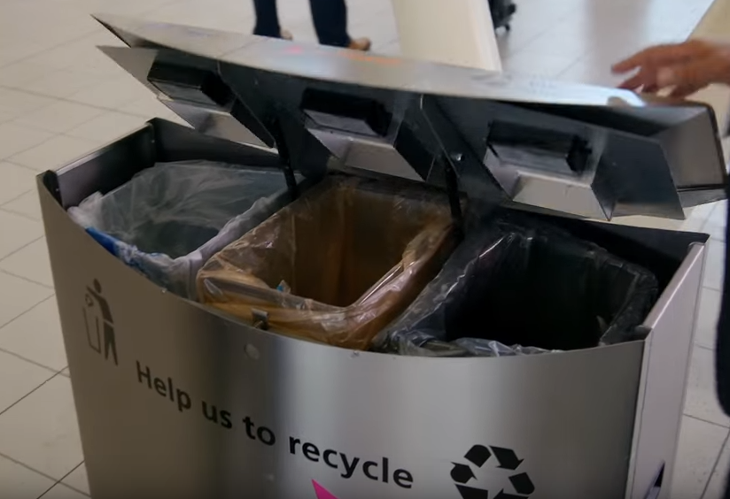
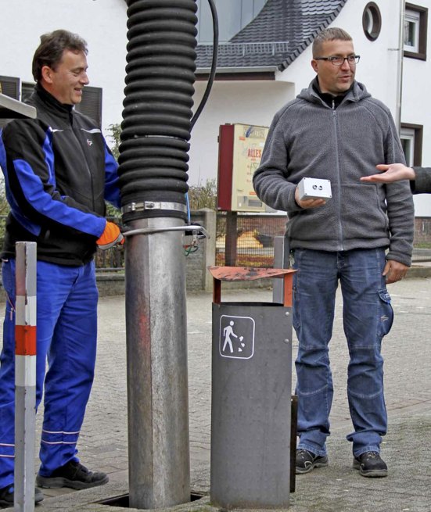
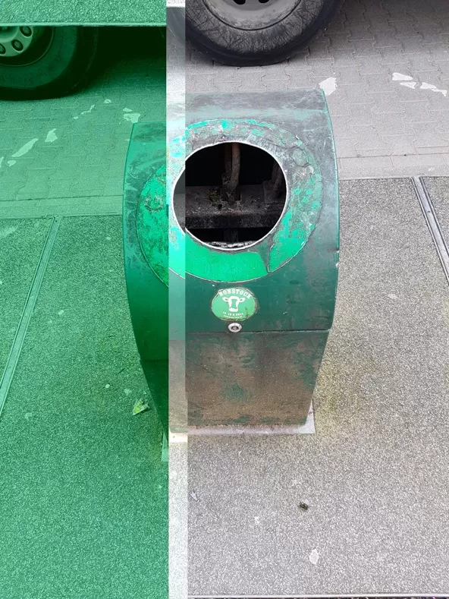
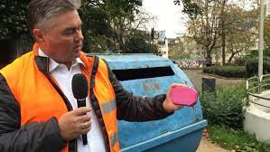
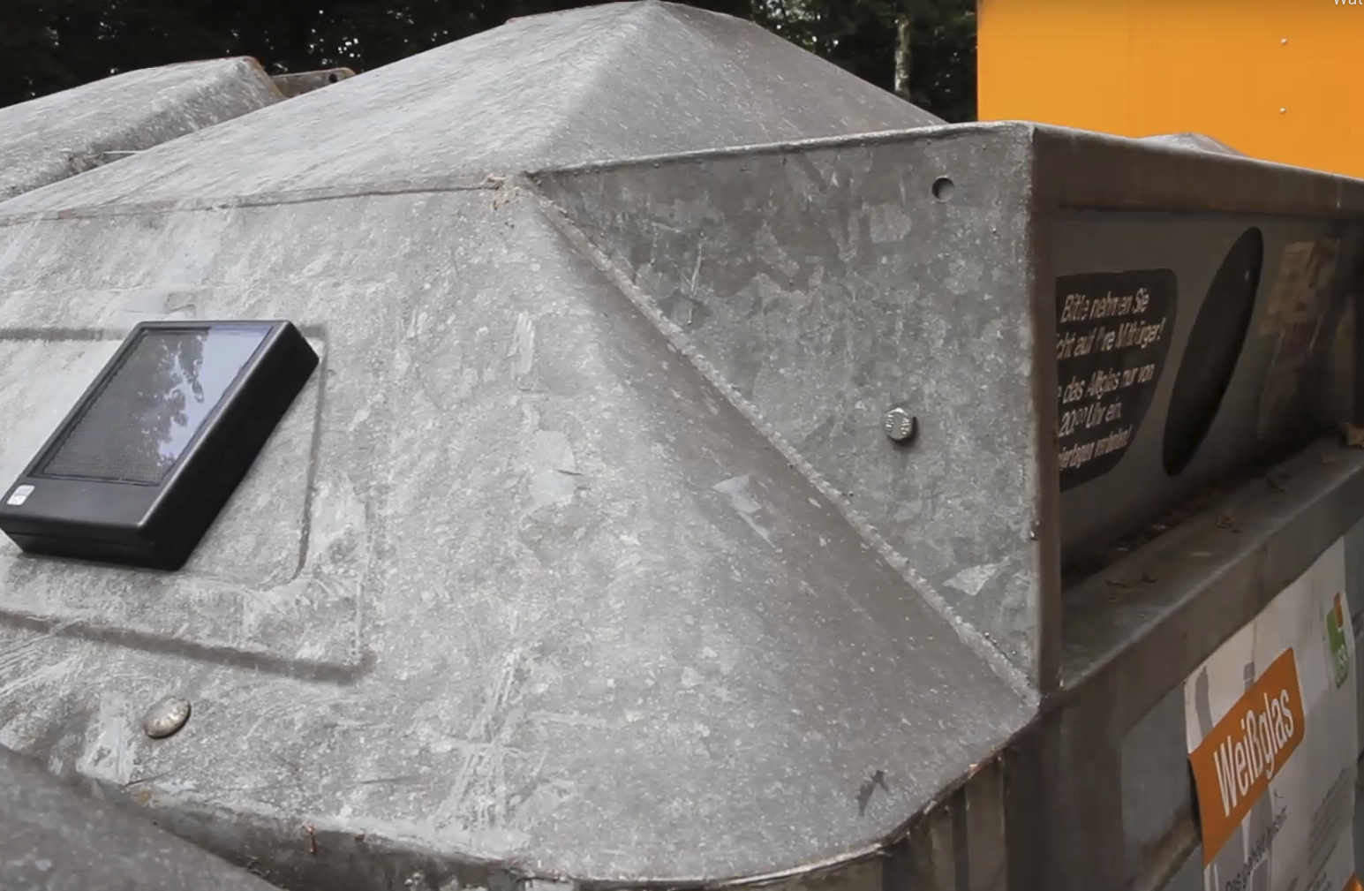
3. Cloud Connectivity of Dustbins
Some of the LPWAN based smart dustbin applications across europe and germany
Schiphol Airport
Karlsruhe
Darmstadt
Bonn
Bochum
Battery +
LoRaWAN
Battery +
LoRaWAN
Solar panel + Sigfox
Battery +
LoRaWAN
Battery +
NB-IoT
Source: https://www.youtube.com/watch?v=9kTeqv8oWP8&t=32s
Source: https://www.ka-news.de/wirtschaft/karlsruhe-innovativ/Karlsruhe-wird-zur-Smart-City-Muelleimer-sollen-kuenftig-selbst-denken;art516981,2177874
Source:
https://www.digitalstadt-darmstadt.de/projekte/smart-waste/
Source: https://www.telekom.com/en/media/media-information/archive/green-light-for-smart-city-bonn-507464
Source:
https://zolitron.com/

Slide 31
3. Cloud Connectivity of Dustbins
Comparison of Low Power Wide Area Networks
Better Performance
 | Unlicensed spectrum (ISM Band) |  | Licensed spectrum
Parameters | LoRaWAN | Sigfox | NB-IoT | LTE-M

Slide 32
3. Cloud Connectivity of Dustbins
Comparison of Low Power Wide Area Networks
Better Performance
 | Unlicensed spectrum (ISM Band) |  | Licensed spectrum
Parameters | LoRaWAN | Sigfox | NB-IoT | LTE-M
Speed | 0.3-50 kbps | 100 kbps | 250 kbps | 1000 kbps
Max payload size | Uplink:243 Bytes, Downlink: 243 Bytes | Uplink: 12 Bytes, Downlink:8 Bytes | Uplink: 1600 Bytes, Downlink: 1600 Bytes | unknown
Max message / day | Uplink:360, Downlink:10 | Uplink:140, Downlink:4 | Uplink:Unlimited Downlink:Unlimited | Uplink:Unlimited Downlink:Unlimited

Slide 33
3. Cloud Connectivity of Dustbins
Comparison of Low Power Wide Area Networks
Better Performance
 | Unlicensed spectrum (ISM Band) |  | Licensed spectrum
Parameters | LoRaWAN | Sigfox | NB-IoT | LTE-M
Speed | 0.3-50 kbps | 100 kbps | 250 kbps | 1000 kbps
Max payload size | Uplink:243 Bytes, Downlink: 243 Bytes | Uplink: 12 Bytes, Downlink:8 Bytes | Uplink: 1600 Bytes, Downlink: 1600 Bytes | unknown
Max message / day | Uplink:360, Downlink:10 | Uplink:140, Downlink:4 | Uplink:Unlimited Downlink:Unlimited | Uplink:Unlimited Downlink:Unlimited
Standardization | lora-alliance | Sigfox | 3GPP | 3GPP

Slide 34
3. Cloud Connectivity of Dustbins
Comparison of Low Power Wide Area Networks
Better Performance
 | Unlicensed spectrum (ISM Band) |  | Licensed spectrum
Parameters | LoRaWAN | Sigfox | NB-IoT | LTE-M
Speed | 0.3-50 kbps | 100 kbps | 250 kbps | 1000 kbps
Max payload size | Uplink:243 Bytes, Downlink: 243 Bytes | Uplink: 12 Bytes, Downlink:8 Bytes | Uplink: 1600 Bytes, Downlink: 1600 Bytes | unknown
Max message / day | Uplink:360, Downlink:10 | Uplink:140, Downlink:4 | Uplink:Unlimited Downlink:Unlimited | Uplink:Unlimited Downlink:Unlimited
Standardization | lora-alliance | Sigfox | 3GPP | 3GPP
Service fee | free | 9-20 € / year | 7-30€ / 5 year | 30-120$ / year

Slide 35
3. Cloud Connectivity of Dustbins
Comparison of Low Power Wide Area Networks
Better Performance
 | Unlicensed spectrum (ISM Band) |  | Licensed spectrum
Parameters | LoRaWAN | Sigfox | NB-IoT | LTE-M
Speed | 0.3-50 kbps | 100 kbps | 250 kbps | 1000 kbps
Max payload size | Uplink:243 Bytes, Downlink: 243 Bytes | Uplink: 12 Bytes, Downlink:8 Bytes | Uplink: 1600 Bytes, Downlink: 1600 Bytes | unknown
Max message / day | Uplink:360, Downlink:10 | Uplink:140, Downlink:4 | Uplink:Unlimited Downlink:Unlimited | Uplink:Unlimited Downlink:Unlimited
Standardization | lora-alliance | Sigfox | 3GPP | 3GPP
Service fee | free | 9-20 € / year | 7-30€ / 5 year | 30-120$ / year
Power Consumption | Extremely Low | Extremely Low | Relatively higher | Relatively higher

Slide 36
3. Cloud Connectivity of Dustbins
Comparison of Low Power Wide Area Networks
Better Performance
 | Unlicensed spectrum (ISM Band) |  | Licensed spectrum
Parameters | LoRaWAN | Sigfox | NB-IoT | LTE-M
Speed | 0.3-50 kbps | 100 kbps | 250 kbps | 1000 kbps
Max payload size | Uplink:243 Bytes, Downlink: 243 Bytes | Uplink: 12 Bytes, Downlink:8 Bytes | Uplink: 1600 Bytes, Downlink: 1600 Bytes | unknown
Max message / day | Uplink:360, Downlink:10 | Uplink:140, Downlink:4 | Uplink:Unlimited Downlink:Unlimited | Uplink:Unlimited Downlink:Unlimited
Standardization | lora-alliance | Sigfox | 3GPP | 3GPP
Service fee | free | 9-20 € / year | 7-30€ / 5 year | 30-120$ / year
Power Consumption | Extremely Low | Extremely Low | Relatively higher | Relatively higher
LoRaWAN is the most suitable LPWAN Technology for the smart dustbin concept

Slide 37
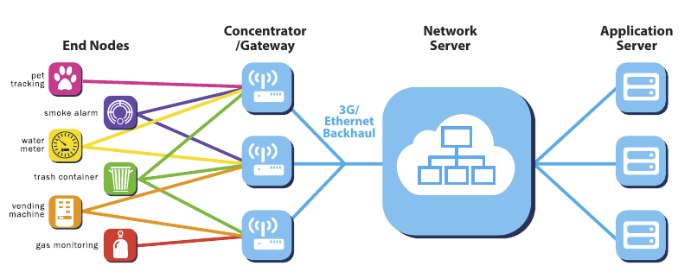
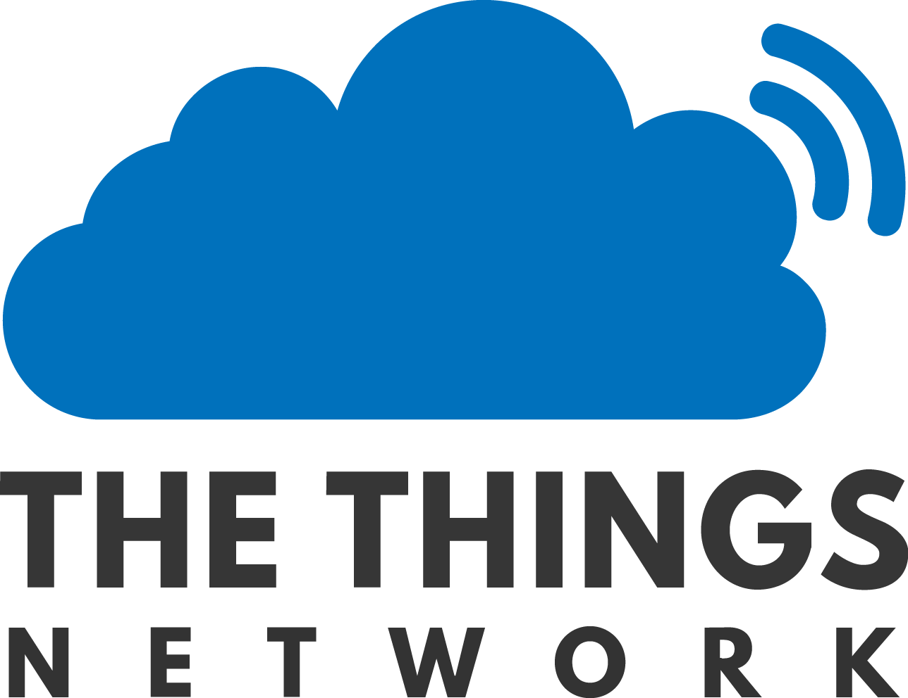
3. Cloud Connectivity of Dustbins
Public LoRaWAN: Global Open Network The Things Network (TTN)
https://www.thethingsnetwork.org/
https://www.thethingsnetwork.org/u/elab_berlin

Slide 38
3. Cloud Connectivity of Dustbins
Public LoRaWAN: Global Open Network The Things Network (TTN)
https://www.thethingsnetwork.org/
Crowd funded
https://www.thethingsnetwork.org/u/elab_berlin

Slide 39
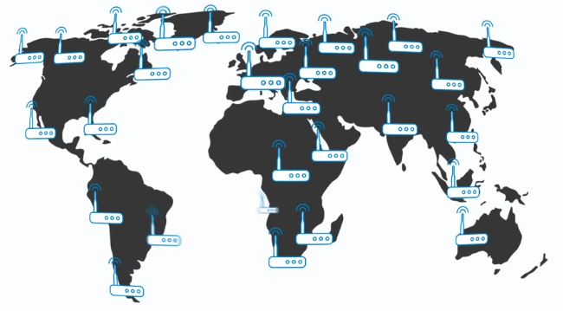
3. Cloud Connectivity of Dustbins
Public LoRaWAN: Global Open Network The Things Network (TTN)
https://www.thethingsnetwork.org/
Crowd funded
151 countries
19471 gateways
142141 members
https://www.thethingsnetwork.org/
https://www.thethingsnetwork.org/u/elab_berlin

Slide 40

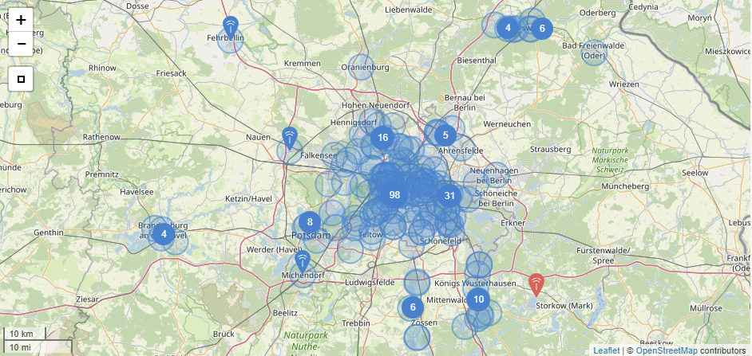
3. Cloud Connectivity of Dustbins
Public LoRaWAN: Global Open Network The Things Network (TTN)
TTN Berlin
4th city with the most TTN gateways in the world
BSR as a core contributor
Coverage Map
https://www.thethingsnetwork.org/
Crowd funded
151 countries
19471 gateways
142141 members
https://www.thethingsnetwork.org/
https://www.thethingsnetwork.org/community/berlin/

Slide 41
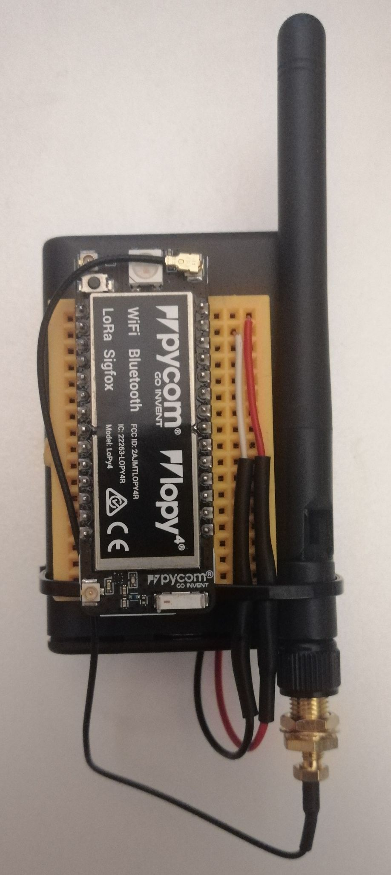
3. Cloud Connectivity of Dustbins
Smart dustbin field test using the TTN
Prototype and field test
Hardware test unit
WiFi Antenna
Battery
LoRaWAN Module

Slide 42
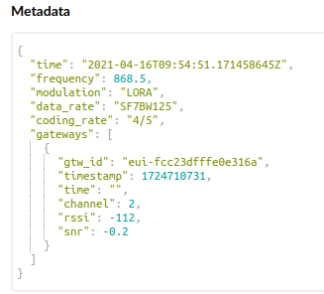
3. Cloud Connectivity of Dustbins
Smart dustbin field test using the TTN
Prototype and field test
Hardware test unit
Successful connection to the TTN
WiFi Antenna
Battery
LoRaWAN Module
Result
Successfully connection to internet without using WiFi or cellular communication.

Slide 43
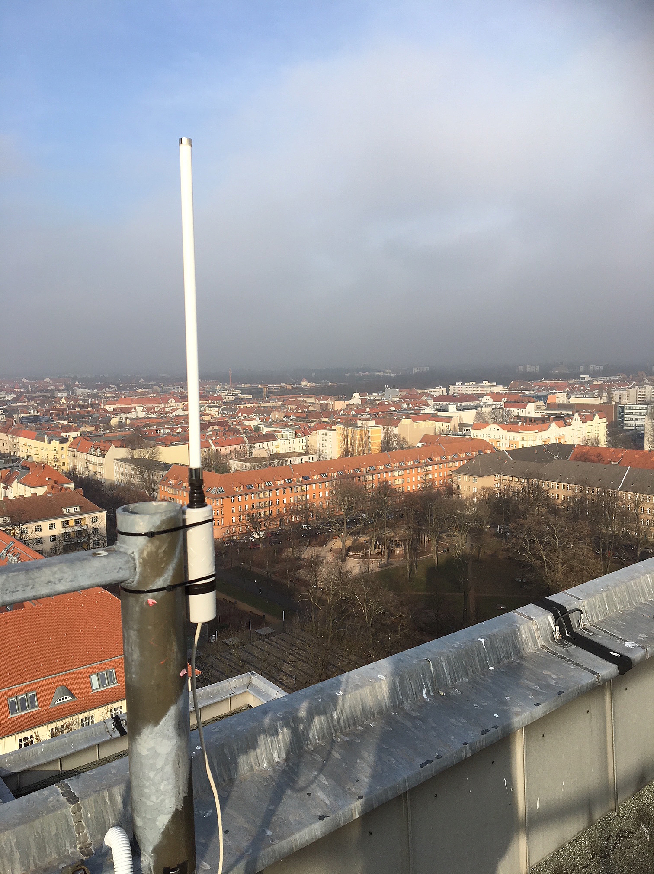
3. Cloud Connectivity of Dustbins
Smart dustbin field test using the TTN
Prototype and field test
Hardware test unit
Successful connection to the TTN
WiFi Antenna
Battery
LoRaWAN Module
Result
Successfully connection to internet without using WiFi or cellular communication.
https://www.technologiestiftung-berlin.de/de/blog/lorawan-ueber-517-kilometer/
LoRaWAN Gateway at Beuth Hochschule

Slide 44
4. Application Server of the MURMEL Network

Slide 45
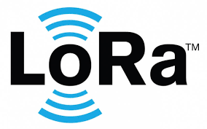
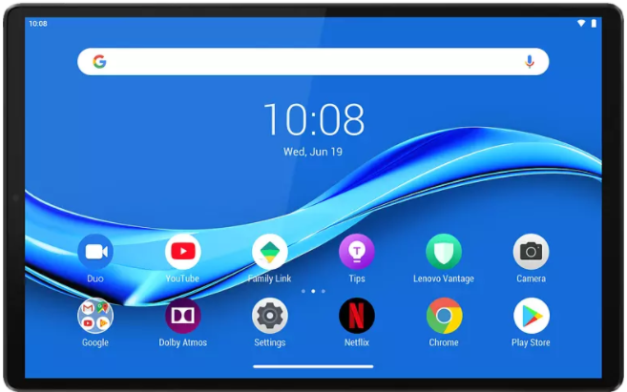
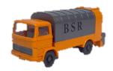

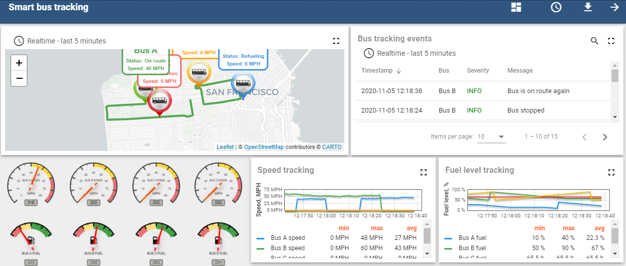

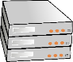
4. MURMEL Application Server
MURMEL Application Server as a central element in the communication network.
LoRaWAN
TTN
Operator 1
MURMEL Application Server
Operator 2
4G
BSR Application Server
Backhaul Internet Connection

Slide 46
4. MURMEL Application Server
MURMEL Application Server consists of 4 main components

Slide 47
4. MURMEL Application Server
MURMEL Application Server consists of 4 main components
Back End
Front End
Dustbin
TTN Application Server
MQTT node
WS node
Telemetry
MQTT Server
Communication Protocol
MQTT
Lightweight communication protocol to handle telemetry data.

Slide 48
4. MURMEL Application Server
MURMEL Application Server consists of 4 main components
Back End
Front End
Dustbin
TTN Application Server
MQTT node
WS node
Telemetry
MQTT Server
Thingsboard Server
Visualization Service
Communication Protocol
Visualization Service
MQTT
Lightweight communication protocol to handle telemetry data.
Thingsboard
An IoT Platform with dashboard feature supporting static and dynamic widgets to create UI.

Slide 49
4. MURMEL Application Server
MURMEL Application Server consists of 4 main components
Back End
Front End
Dustbin
TTN Application Server
Sumo Server
HTTP Server
Route Planning Service
MQTT node
WS node
Telemetry
MQTT Server
Thingsboard Server
Visualization Service
Route
WebSocket Server
Communication Protocol
Visualization Service
Route Planning Service
MQTT
Lightweight communication protocol to handle telemetry data.
Thingsboard
An IoT Platform with dashboard feature supporting static and dynamic widgets to create UI.
SUMO + WebSocket + HTTP
An interface to push route update to robots

Slide 50
4. MURMEL Application Server
MURMEL Application Server consists of 4 main components
Back End
Front End
Dustbin
Video Streaming Service
TTN Application Server
Sumo Server
HTTP Server
Route Planning Service
MQTT node
WS node
Telemetry
MQTT Server
Thingsboard Server
Visualization Service
Route/video
WebSocket Server
Communication Protocol
Visualization Service
Route Planning Service
Video Streaming Service
MQTT
Lightweight communication protocol to handle telemetry data.
Thingsboard
An IoT Platform with dashboard feature supporting static and dynamic widgets to create UI.
SUMO + WebSocket + HTTP
An interface to push route update to robots
WebSocket + HTTP
An interface to access robots cameras

Slide 51
4. MURMEL Application Server
MURMEL Application Server consists of 4 main components
Back End
Front End
Dustbin
Video Streaming Service
TTN Application Server
Sumo Server
HTTP Server
Route Planning Service
Database Server
MQTT node
WS node
Telemetry
MQTT Server
Thingsboard Server
Visualization Service
Route/video
WebSocket Server
Communication Protocol
Visualization Service
Route Planning Service
Video Streaming Service
MQTT
Lightweight communication protocol to handle telemetry data.
Thingsboard
An IoT Platform with dashboard feature supporting static and dynamic widgets to create UI.
SUMO + WebSocket + HTTP
An interface to push route update to robots
WebSocket + HTTP
An interface to access robots cameras

Slide 52
5. Simulation

Slide 53
5. Sample Simulation of a MURMEL Application
Simulation environment for a sample MURMEL application
Components
SUMO
ROS
Python
Thingsboard

Slide 54
5. Sample Simulation of a MURMEL Application
Simulation environment for a sample MURMEL application
Components
SUMO
ROS
Python
Thingsboard
Simulation Architecture
SUMO
ROS
MURMEL Application Server
Python
Route Coordinates
Dustbin Coordinates
MQTT, WebSocket and
Camera connections
HTTP and WebSocket
Servers
Thingsboard

Slide 55
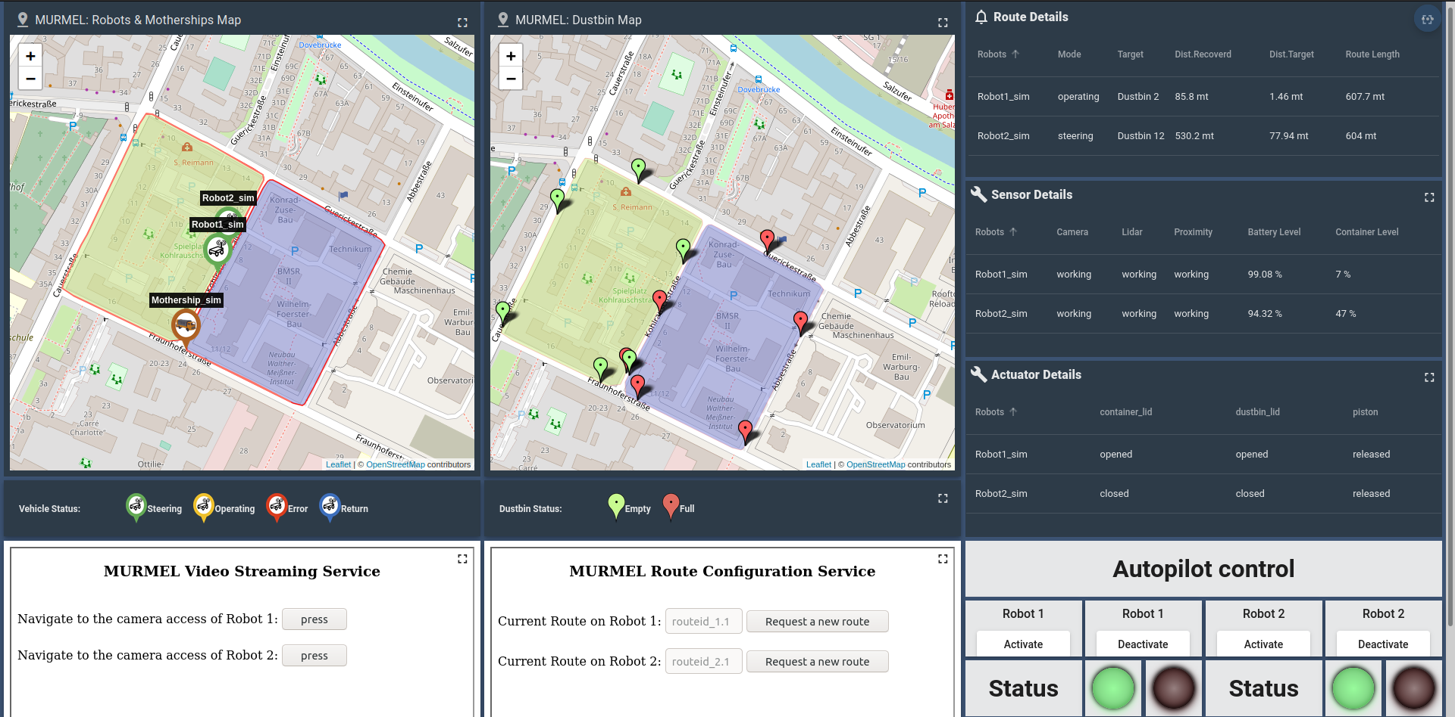
5. Sample Simulation of a MURMEL Application
Dashboard layout for a sample MURMEL operation consists of two robots.

Slide 56
6. Conclusion
The resulting MURMEL communication network consists of
4G based robot connections
LoRaWAN based dustbin connections
MURMEL Application Server

Slide 57
6. Conclusion
The resulting MURMEL communication network consists of
4G based robot connections
LoRaWAN based dustbin connections
MURMEL Application Server
MURMEL Application Server
Dustbin
LoRaWAN
TTN
Back End
Front End
Operator 1
Sumo Server
HTTP Server
Database Server
MQTT node
WS node
Operator 2
4G
MQTT Server
Thingsboard Server
WebSocket Server
BSR Application Server
Backhaul Internet Connection

Slide 58
6. Future Work
Improvements of the system can be still done
LoRaWAN coverage in Berlin is still not 100%
No signal in Ernst Reuter Platz.
More TTN Gateways are needed to be installed.

Slide 59
6. Future Work
Improvements of the system can be still done
LoRaWAN coverage in Berlin is still not 100%
No signal in Ernst Reuter Platz.
More TTN Gateways are needed to be installed.
Integration of Route Planning Algorithm with backend is needed.

Slide 60
6. Future Work
Improvements of the system can be still done
LoRaWAN coverage in Berlin is still not 100%
No signal in Ernst Reuter Platz.
More TTN Gateways are needed to be installed.
Integration of Route Planning Algorithm with backend is needed.
In detail analysis of cyber security aspects of the network is required
Transportation layer is encrypted
Client and Server side measurements are missing

Slide 61
Sources
https://www.technologiestiftung-berlin.de/de/blog/lorawan-ueber-517-kilometer/
https://www.thethingsnetwork.org/community/berlin/post/this-is-big-news-1st-ttn-gateway-at-250-m-height-on-top-of-tv-tower-berlin-fernsehturm
https://www.chemie.tu-berlin.de/fileadmin/i10_wheelswaysweights/Projekt/Cargobikometer/SAI-Lab_Cargobikometer_Freifunk.pdf
https://clair-berlin.de/
https://www.citylab-berlin.org/projects/clair/
https://www.deutschebahn.com/de/Digitalisierung/technologie/internet_of_things-3241374
https://www.deutschebahn.com/de/Digitalisierung/technologie/digitaler_alltag/lorawan-3232292
https://www.thethingsnetwork.org/community/berlin/post/german-railways-1st-outside-field-testing-of-paxcounter-using-ttn-berlin-central-railway-station
https://www.thethingsnetwork.org/community/berlin/post/berlin-festigt-seine-nationale-smart-city-vorreiterposition
https://zenner-iot.com/
https://www.kerlink.com/lora/
https://www.thethingsnetwork.org/community/berlin/post/der-iot-zoo-der-deutschen-bah-ag-wachst-weiter
https://www.youtube.com/watch?v=31AhzOoprPw&t=545s
https://sensoneo.com/optimize-waste-collection-routes/
https://www.startus-insights.com/innovators-guide/5-top-smart-bin-solutions-impacting-smart-cities/
https://www.telekom.com/en/media/media-information/archive/bye-bye-3g-now-lte-is-coming-for-everyone-608220

Slide 62
Sources
https://iot.telekom.com/en/solutions/drive-track
https://www.digi.com/videos/what-are-the-differences-between-lte-m-and-nb-iot
https://www.management-circle.de/blog/der-digitale-bahnhof-fernueberwachung-von-bahnhofsuhren-mit-lorawan/
https://buy.sigfox.com/buy/offers/DE
https://iot.telekom.com/en/networks-tariffs/iot-tariffs/business-smart-connect
https://www.att.com/support/article/wireless/KM1324171/
https://www.thethingsnetwork.org/forum/t/limitations-data-rate-packet-size-30-seconds-uplink-and-10-messages-downlink-per-day-fair-access-policy-guidelines/1300
https://marketplace.att.com/products/att-iot-dataplans-lte-m-us
https://tech-journal.semtech.com/understanding-the-lorawan-architecture
https://smart-city-berlin.de/projektliste/project-detail?tx_news_pi1%5Bnews%5D=737&cHash=ebf5c42840a8f76f58b280af51dae247
https://lora-developers.semtech.com/library/tech-papers-and-guides/lora-and-lorawan/
https://www.thethingsnetwork.org/

Slide 63
Thank you for your attention

Slide 64
Backup Slides

Slide 65
Introduction
Defining the communication requirements
MURMEL Communication network consists of three elements
Robots
Dustbins
Application Server
Each of the element has its own requirement
Dustbins
Robots
Application Server
Low power consumption
There is no power source
Uplink communication
2-3 messages per hour
Scalability and financial feasibility
22.000 dustbins in Berlin
Uplink and downlink communication
Uplink: Telemetry data, GPS
Downlink: streaming and autopilot control
Data transfer in short intervals
Sending telemetry each 10 seconds
Must support
Web applications
IOS/Android

Slide 66
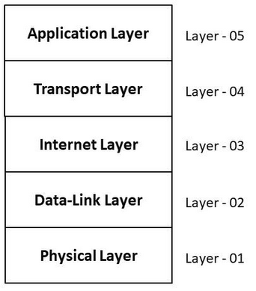

Introduction
Methodology
TCP/IP Model as guideline for the MURMEL Network
MURMEL Application Server

Slide 67
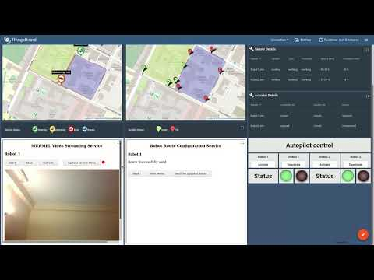
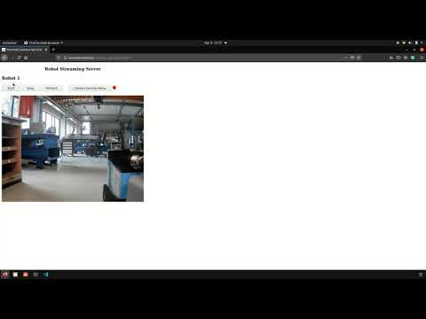
5. Sample Simulation of a MURMEL Application
Simulation video
Camera Access video

Slide 68
2. Physical Layer of the MURMEL Network

Slide 69
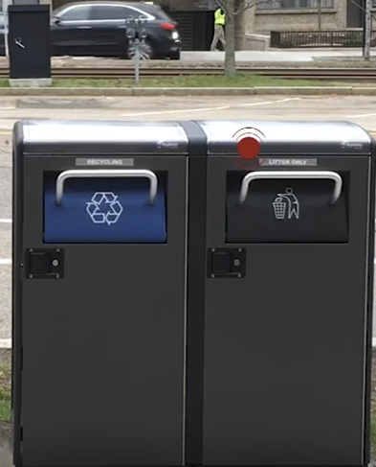
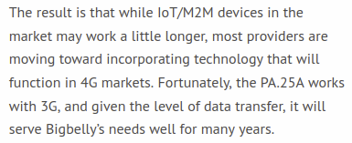
3. Physical layer of the MURMEL Network
Defining the Physical Layer of Smart Dustbins
2G&3G based smart dustbin applications require hardware update in near feature !!
USA, UK ...
Solar panel + 2G&3G
https://www.taoglas.com/bigbelly-uses-taoglas-antennas-to-create-smart-trash-cans/
Source: https://www.youtube.com/watch?v=gwDXldBLusc
Source: https://zolitron.com/

Slide 70
3. Cloud Connectivity of Dustbins
LoRaWAN Architecture
https://www.thethingsnetwork.org/

Slide 71
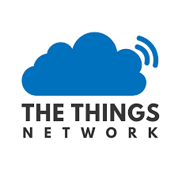

3. Cloud Connectivity of Dustbins
LoRaWAN Architecture
Comparison between LoRaWAN deployment models
Cost factors for deployments | Local Private Network | Public Network Operator | Open community network
Subscription fee | - | € | -
Gateway Infrastructure & Maintenance | € | - | -
Network Operations & Maintenance | € | - | -
https://www.thethingsnetwork.org/
LoRaWAN can be deployed in three ways.
1. Local Private
Network
2.Public Network Operator
3.Open community network
https://zenner-iot.com/page/downloads/
https://www.thethingsnetwork.org/

Slide 72
3. Cloud Connectivity of Dustbins
LoRaWAN Architecture
Comparison between LoRaWAN deployment models
Cost factors for deployments | Local Private Network | Public Network Operator | Open community network
Subscription fee | - | € | -
Gateway Infrastructure & Maintenance | € | - | -
Network Operations & Maintenance | € | - | -
https://www.thethingsnetwork.org/
LoRaWAN can be deployed in three ways.
1. Local Private
Network
2.Public Network Operator
3.Open community network
Open Community Network is chosen for prototype testing
https://zenner-iot.com/page/downloads/
https://www.thethingsnetwork.org/

Slide 73
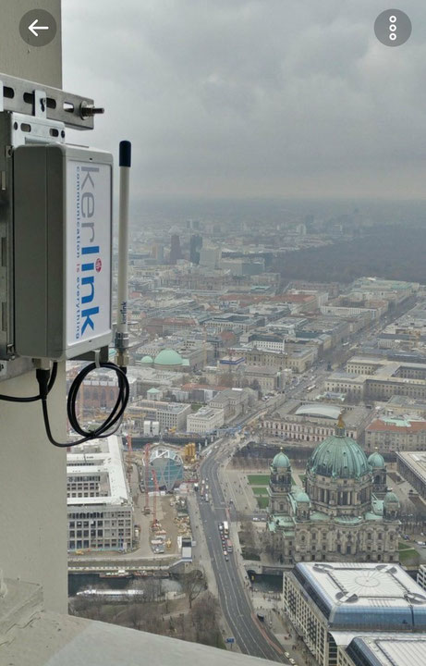
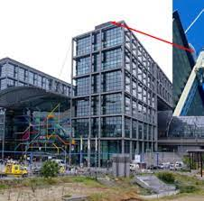
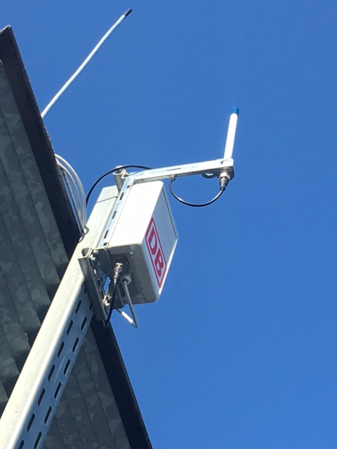
3. Cloud Connectivity of Dustbins
Public LoRaWAN: Global Open Network The Things Network (TTN)
Some TTN Gateways in Berlin
Beuth Hochschule
TV Tower
Hauptbahnhof
https://www.technologiestiftung-berlin.de/de/blog/lorawan-ueber-517-kilometer/
https://www.thethingsnetwork.org/community/berlin/post/this-is-big-news-1st-ttn-gateway-at-250-m-height-on-top-of-tv-tower-berlin-fernsehturm
https://www.management-circle.de/blog/der-digitale-bahnhof-fernueberwachung-von-bahnhofsuhren-mit-lorawan/

Slide 74
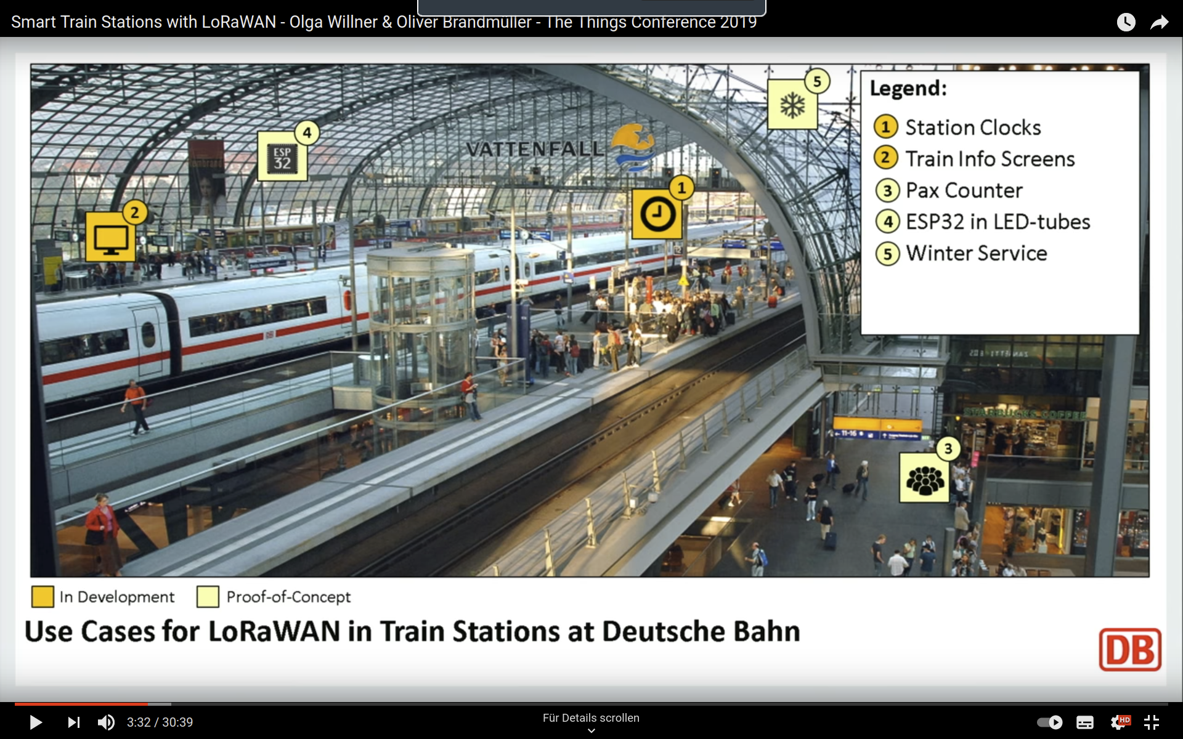
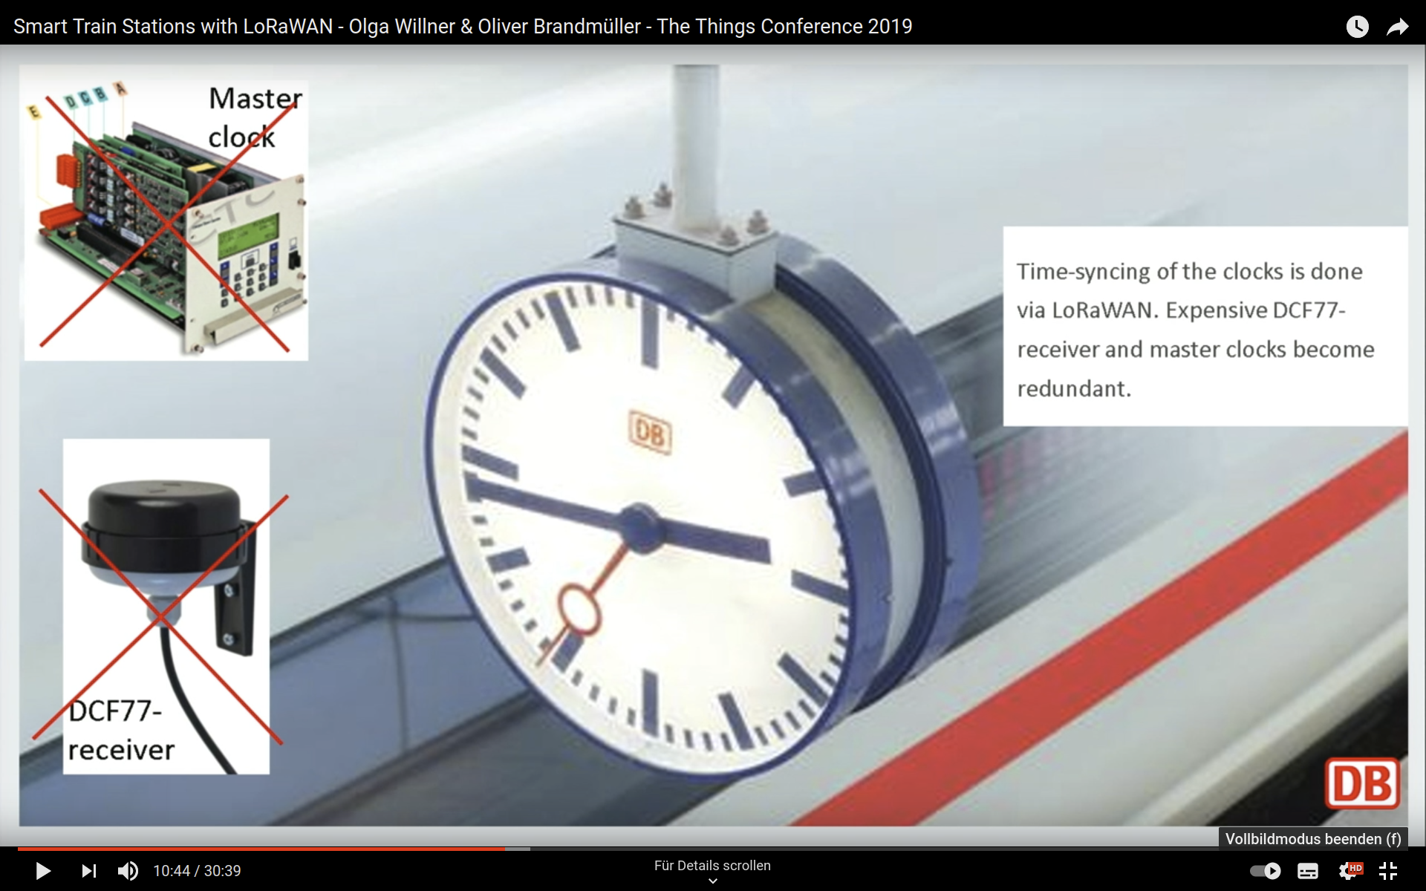
3. Cloud Connectivity of Dustbins
LoRaWAN Use Cases
Deutsche Bahn
https://www.youtube.com/watch?v=7zXNnb2qr6s&pp=qAMBugMGCgJkZRAB
https://www.youtube.com/watch?v=31AhzOoprPw

Slide 75
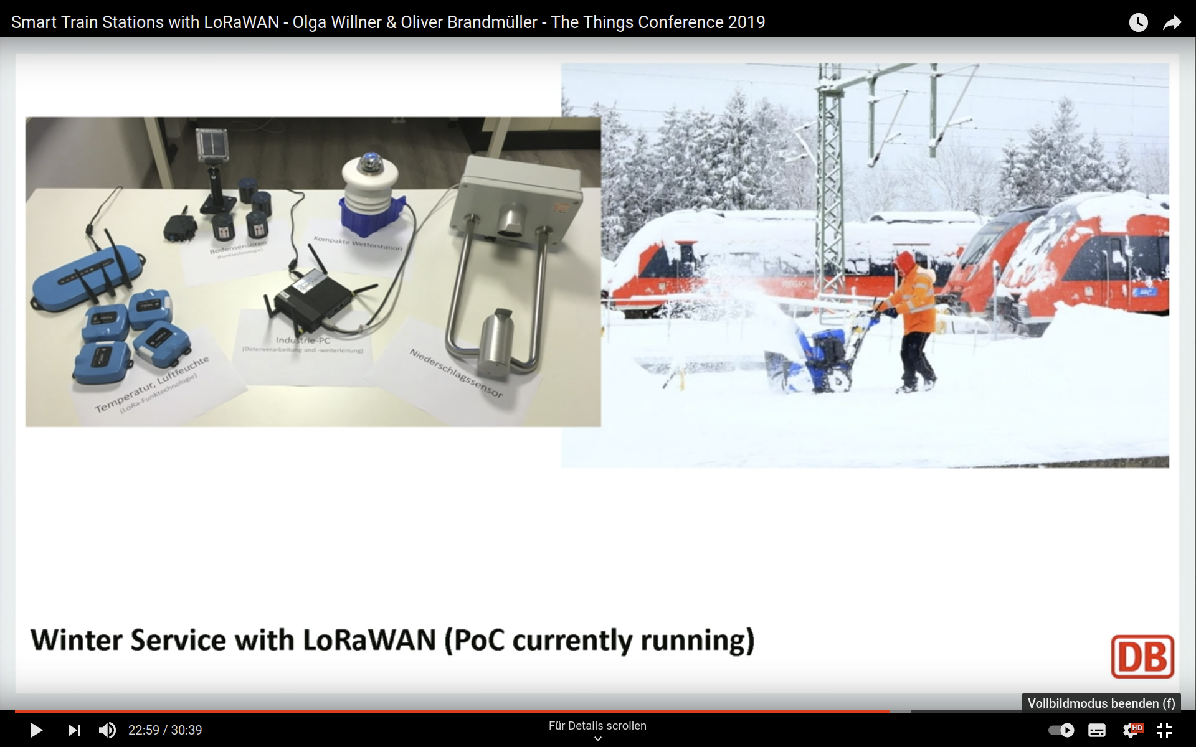
3. Cloud Connectivity of Dustbins
LoRaWAN Use Cases
Deutsche Bahn
https://www.youtube.com/watch?v=7zXNnb2qr6s&pp=qAMBugMGCgJkZRAB
https://www.youtube.com/watch?v=31AhzOoprPw

Slide 76
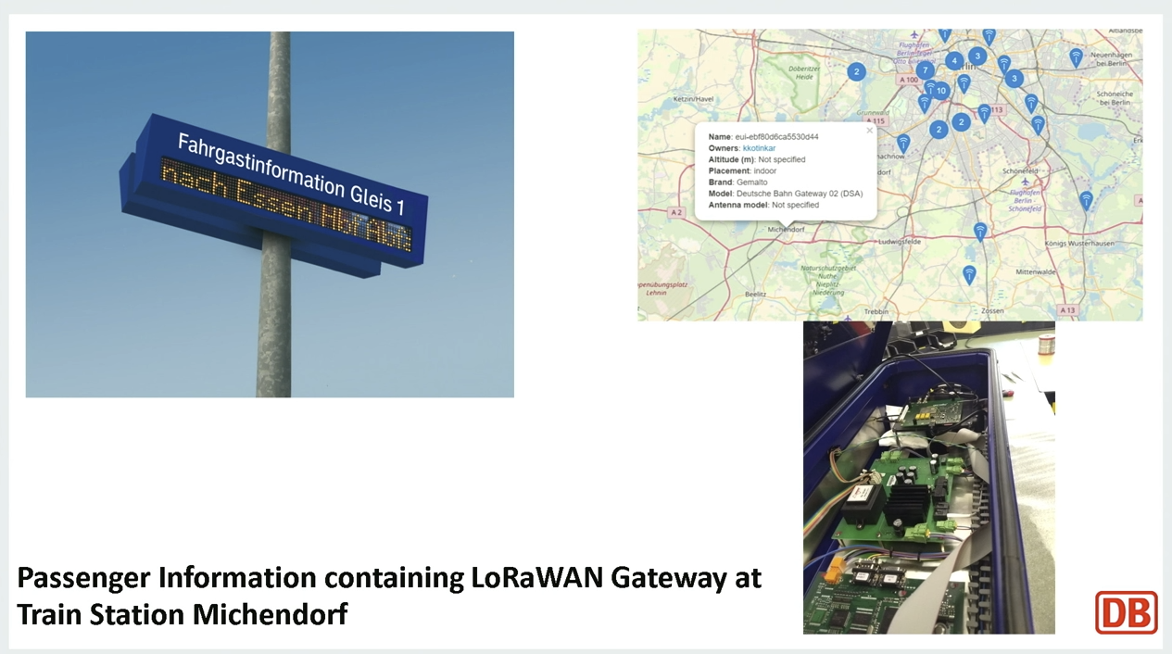
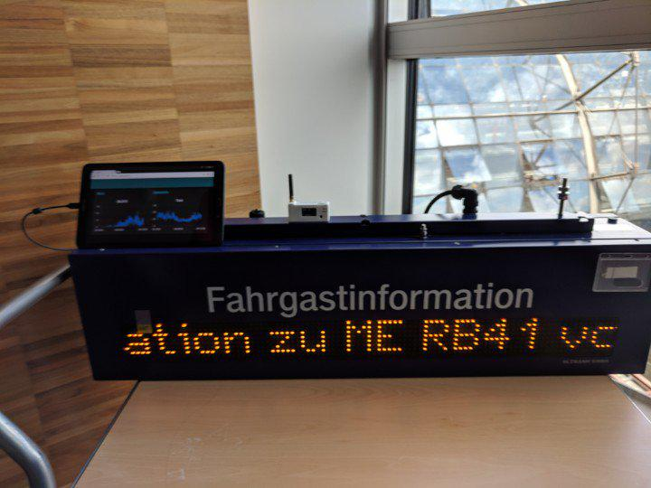
3. Cloud Connectivity of Dustbins
LoRaWAN Use Cases
Deutsche Bahn
https://www.thethingsnetwork.org/community/berlin/post/german-railways-1st-outside-field-testing-of-paxcounter-using-ttn-berlin-central-railway-station
https://www.youtube.com/watch?v=7zXNnb2qr6s&pp=qAMBugMGCgJkZRAB
https://www.youtube.com/watch?v=31AhzOoprPw

Slide 77
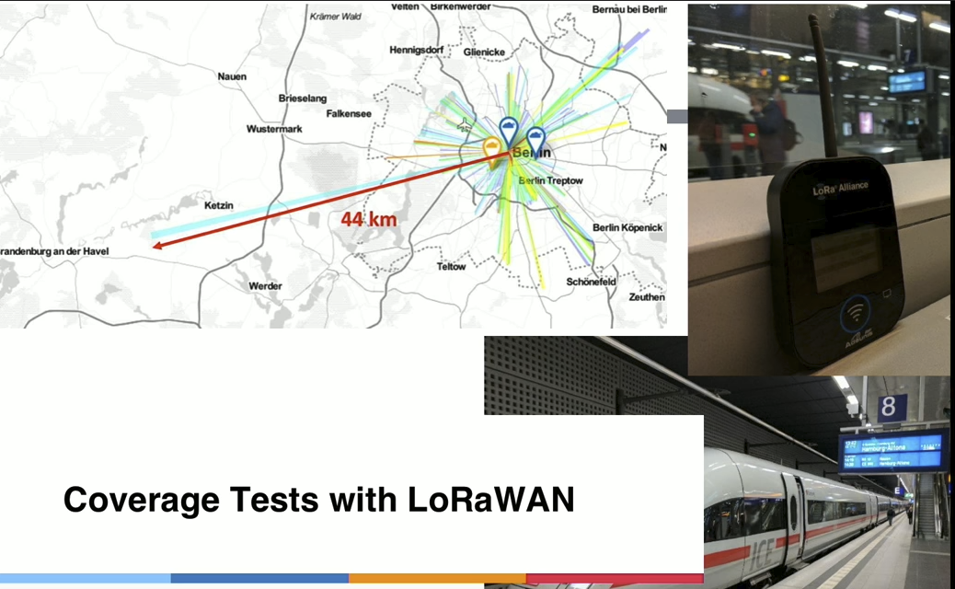
3. Cloud Connectivity of Dustbins
LoRaWAN Use Cases
Deutsche Bahn
https://www.youtube.com/watch?v=7zXNnb2qr6s&pp=qAMBugMGCgJkZRAB
https://www.youtube.com/watch?v=31AhzOoprPw

Slide 78
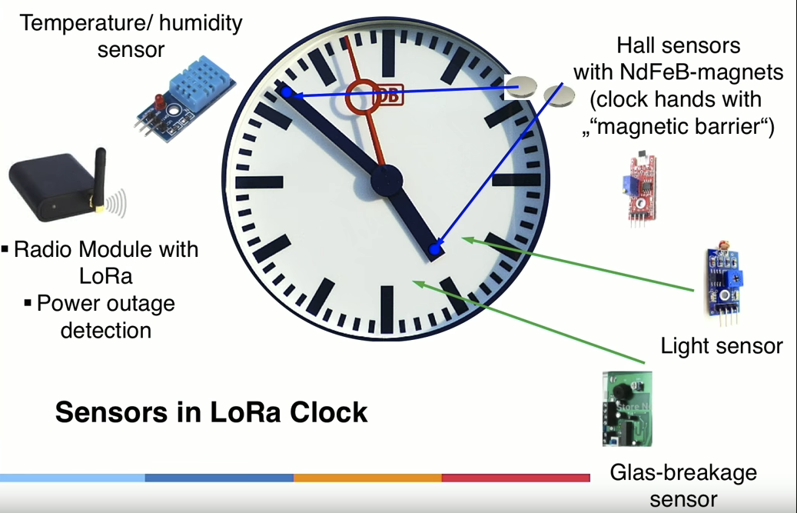


3. Cloud Connectivity of Dustbins
LoRaWAN Use Cases
Deutsche Bahn
Smart Damage Report
Crowd Estimating
Clock Synchronization
https://www.youtube.com/watch?v=7zXNnb2qr6s&pp=qAMBugMGCgJkZRAB
https://www.youtube.com/watch?v=31AhzOoprPw

Slide 79



3. Physical layer of the MURMEL Network
Defining the Physical Layer of Smart Dustbins
TTN Network Coverage Test in Berlin
Prototype and field test
Hardware test unit
Result
In some parts of Berlin TTN has a good coverage but there are still places without TTN network such as Ernst Reuter Platz.
Battery
WiFi Antenna
GPS Module
LoRaWAN Module

Slide 80
4. Application Layer of the MURMEL Network

Slide 81
4. Application Layer of the MURMEL Network
Smart dustbins using LPWAN
Application layer of the MURMEL Network consists of 4 main components
Communication Protocol
Visualization Service
Route Planning Server
Video Streaming Server
Communication Protocol
Visualization Service
*Route Planning Service
Video Streaming Service
Lightweight communication protocol to handle telemetry data.
An IoT Platform with dashboard feature supporting static and dynamic widgets to create UI.
An interface to push route update to robots
An interface to access robots cameras
*Still under development

Slide 82

4. Application Layer of the MURMEL Network
Two most common IoT communication protocols for sending telemetry messages are MQTT and CoAP
Communication Protocol
MQTT Architecture
✔
Publish “fillness”
Subscribe “fillness”
Server
Client
Client
Client
CoAP Architecture
Request
Client
Server
Response
CoAP is based on server / client structure and not suitable for IPv4 in LTE
MQTT has more API support
Client
Server
Client

Slide 83




4. Application Layer of the MURMEL Network
Two most common IoT communication protocols for sending telemetry messages are MQTT and CoAP
Visualization Service
 | Cloud Computing Platform | Open source/limited Dashboard services
Price | High, >300€ /Month | Middle, 0€~150€ /Month
System Complexity | High | Low
Development effort | High | Low
✔
https://thingsboard.io/
https://thethings.io/iot-dashboards-features/
https://openautomationsoftware.com/products/data/azure-iot-gateway-interface/

Slide 84
4. Application Layer of the MURMEL Network
Smart dustbins using LPWAN
WebSocket based camera service for accessing to robots’ camera view.
Video Streaming Server
WebSocket based camera service for accessing to robots’ camera view.
Camera Service
Back End
Front End
Frame
Camera Service
HTTP Server
Frame
Robot
WS Node
Frame
WebSocket Server
Start / Stop

Slide 85

4. Application Layer of the MURMEL Network
Smart dustbins using LPWAN
SUMO based Route Planning Service for updating the routes on robots.
Route Planning Server
Mothership Operator
Request Response Push
Route Service
Back End
Front End
Route
Verification
Route
Verification
Sumo Server
HTTP Server
Route Service
Robot
WS node
Route
WebSocket Server
Route

Slide 86
3. Physical layer of the MURMEL Network
Defining the Physical Layer of Robots
Integration of the connectivity nodes into robots
Node: MQTT Client
Node: WebSocket Client
ID: 1
Telemetry
Murmel Application Server
Route,Video
4G
MQTT Server
WebSocket Server
Node: MQTT Client
Node: WebSocket Client
ID: 2
Telemetry
Route,Video

